Slide 1
Data Mining:
Concepts and Techniques
— Chapter 2 —
Jiawei Han, Micheline Kamber, and Jian Pei
University of Illinois at Urbana-Champaign
Simon Fraser University
©2011 Han, Kamber, and Pei. All rights reserved.

Slide 2
Chapter 2: Getting to Know Your Data
Data Objects and Attribute Types
Basic Statistical Descriptions of Data
Data Visualization
Measuring Data Similarity and Dissimilarity
Summary

Slide 3


Types of Data Sets
Record
  Relational records
  Data matrix, e.g., numerical matrix, crosstabs
  Document data: text documents: term-frequency vector
  Transaction data
Graph and network
  World Wide Web
  Social or information networks
  Molecular Structures
Ordered
  Video data: sequence of images
  Temporal data: time-series
  Sequential Data: transaction sequences
  Genetic sequence data
Spatial, image and multimedia:
  Spatial data: maps
  Image data:
  Video data:

Slide 4
Attributes
Attribute (or dimensions, features, variables): a data field, representing a characteristic or feature of a data object.
  E.g., customer _ID, name, address
Types:
  Nominal
  Binary
  Numeric: quantitative
    Interval-scaled
    Ratio-scaled

Slide 5
Attribute Types
Nominal: categories, states, or “names of things”
  Hair_color = {auburn, black, blond, brown, grey, red, white}
  marital status, occupation, ID numbers, zip codes
Binary
  Nominal attribute with only 2 states (0 and 1)
  Symmetric binary: both outcomes equally important
    e.g., gender
  Asymmetric binary: outcomes not equally important.
    e.g., medical test (positive vs. negative)
    Convention: assign 1 to most important outcome (e.g., HIV positive)
Ordinal
  Values have a meaningful order (ranking) but magnitude between successive values is not known.
  Size = {small, medium, large}, grades, army rankings

Slide 6
Discrete vs. Continuous Attributes
Discrete Attribute
  Has only a finite or countably infinite set of values
    E.g., zip codes, profession, or the set of words in a collection of documents
  Sometimes, represented as integer variables
  Note: Binary attributes are a special case of discrete attributes
Continuous Attribute
  Has real numbers as attribute values
    E.g., temperature, height, or weight
  Practically, real values can only be measured and represented using a finite number of digits
  Continuous attributes are typically represented as floating-point variables

Slide 7
Chapter 2: Getting to Know Your Data
Data Objects and Attribute Types
Basic Statistical Descriptions of Data
Data Visualization
Measuring Data Similarity and Dissimilarity
Summary

Slide 8
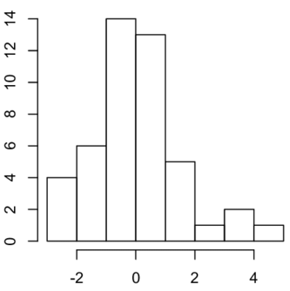
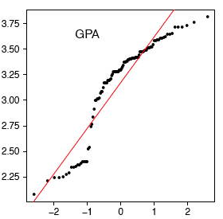
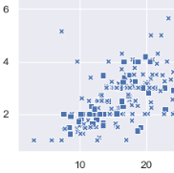
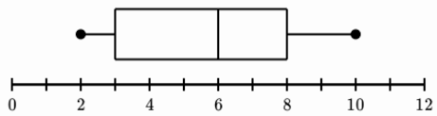
Graphic Displays of Basic Statistical Descriptions
Boxplot: graphic display of five-number summary
Histogram: x-axis are values, y-axis repres. frequencies
Quantile plot: each value x_{i} is paired with f_{i} indicating that approximately 100 f_{i} % of data are ≤ x_{i}
Scatter plot: each pair of values is a pair of coordinates and plotted as points in the plane

Slide 9
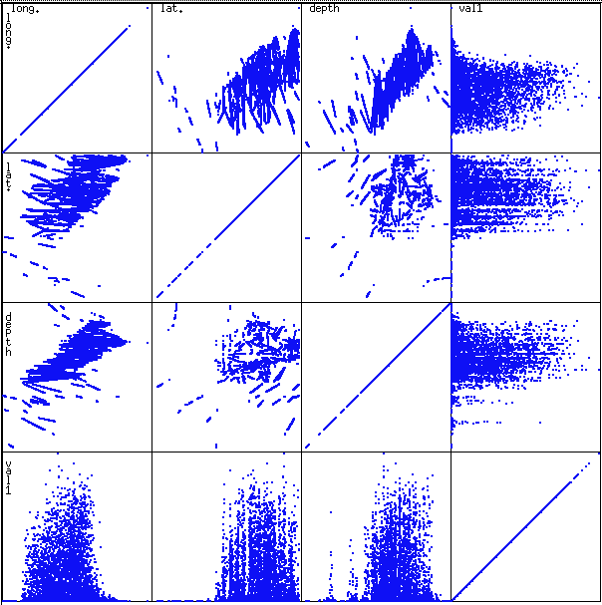
Scatterplot Matrices ( Multidimentional data)
Used by ermission of M. Ward, Worcester Polytechnic Institute
Matrix of scatterplots (x-y-diagrams) of the k-dim. data [total of (k2/2-k) scatterplots]

Slide 10
Chapter 2: Getting to Know Your Data
Data Objects and Attribute Types
Basic Statistical Descriptions of Data
Data Visualization
Measuring Data Similarity and Dissimilarity
Summary

Slide 11
Explore Datamining Package
Download weka from https://www.cs.waikato.ac.nz/ml/weka/downloading.html
https://www.cs.waikato.ac.nz/ml/weka/
Explore basic concept and datasets.
Explore basic visualization techniques.
Explore basic tabs and their functionality.

Slide 12
Similarity and Dissimilarity
Similarity
  Numerical measure of how alike two data objects are
  Value is higher when objects are more alike
  Often falls in the range [0,1]
Dissimilarity (e.g., distance)
  Numerical measure of how different two data objects are
  Lower when objects are more alike
  Minimum dissimilarity is often 0
  Upper limit varies
Proximity refers to a similarity or dissimilarity

Slide 13


Data Matrix and Dissimilarity Matrix
Data matrix
  n data points with p dimensions
  Two modes
Dissimilarity matrix
  n data points, but registers only the distance
  A triangular matrix
  Single mode
Notes:
For example, if we record who is a friend of whom among the members of an organization, the resulting matrix is 1-mode. If we record which faculty would like to teach which courses next semester, the resulting matrix would be 2-mode.

Slide 14

Proximity Measure for Nominal Attributes
Can take 2 or more states, e.g., red, yellow, blue, green (generalization of a binary attribute)
Method 1: Simple matching
  m: # of matches, p: total # of variables
Method 2: Use a large number of binary attributes
  creating a new binary attribute for each of the M nominal states, for example create column for red, and register “Yes” when it is red and “No” when it is not red.

Slide 15
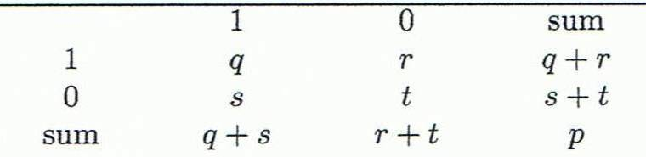
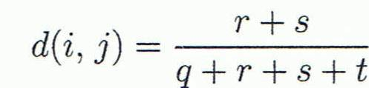
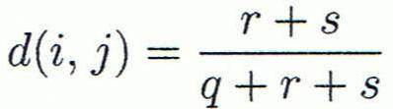
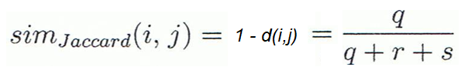
Proximity Measure for Binary Attributes
Object j
A contingency table for binary data
Distance measure for symmetric binary variables:
Distance measure for asymmetric binary variables:
Jaccard coefficient (similarity measure for asymmetric binary variables):
Object i
q هي عدد الحالات التي وجد فيها تطابق لسجلين في حقل معين وكانت قيمة السجلين عند هذا الحقل =1، r هي عدد الحالات التي يكون فيها السجل الأول (i) يساوي 1 والسجل الثاني يساوي 0 لنفس الحقل

Slide 16


Dissimilarity between Binary Variables
Example
  Gender is a symmetric attribute
  The remaining attributes are asymmetric binary
  Let the values Y and P be 1, and the value N 0

Slide 17
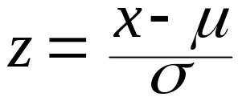
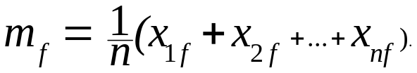
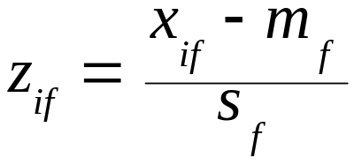
Standardizing Numeric Data
Z-score:
  X: raw score to be standardized, μ: mean of the population, σ: standard deviation
  the distance between the raw score and the population mean in units of the standard deviation
  negative when the raw score is below the mean, “+” when above
An alternative way: Calculate the mean absolute deviation
  where
  standardized measure (z-score):
Using mean absolute deviation is more robust to outliers than using standard deviation, because the distance between the point and mean is not squared

Slide 18

Standardizing Numeric Data
Z-score Example :
Suppose that the mean and standard deviation of the values for the attribute income are $54,000 and $16,000, respectively. What is z-score of income $73,600.
Solution: With z-score normalization, a value of $73,600 for income is transformed to

Slide 19
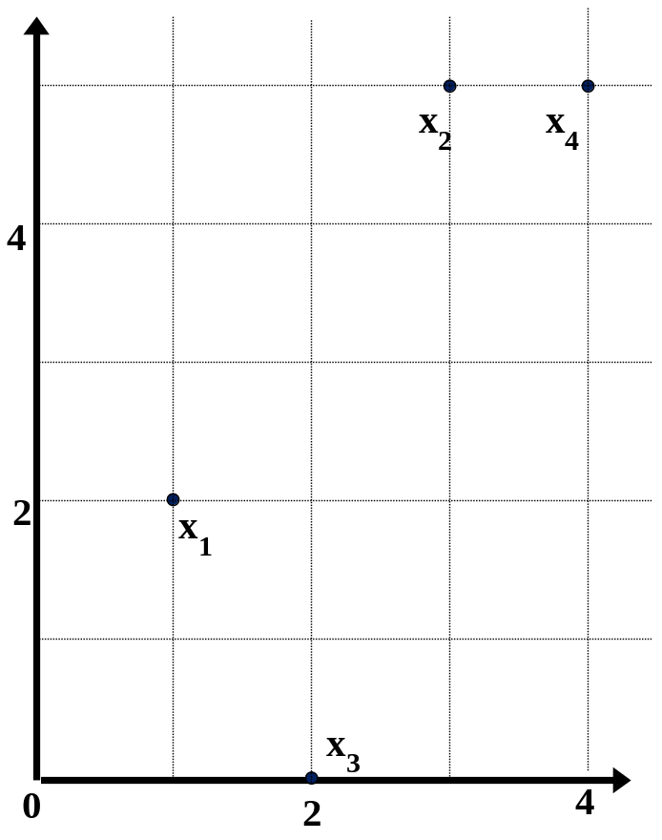
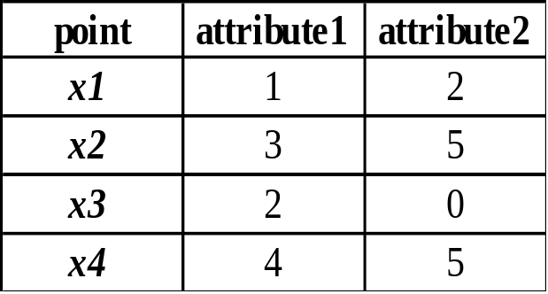
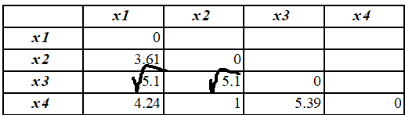
Example:
Data Matrix and Dissimilarity Matrix
Data Matrix
Dissimilarity Matrix
(with Euclidean Distance)

Slide 20
Distance on Numeric Data: Minkowski Distance
Minkowski distance: A popular distance measure
  where i = (x_{i1}, x_{i2}, …, x_{ip}) and j = (x_{j1}, x_{j2}, …, x_{jp}) are two p-dimensional data objects, and h is the order (the distance so defined is also called L-h norm)
Properties
  d(i, j) > 0 if i ≠ j, and d(i, i) = 0 (Positive definiteness)
  d(i, j) = d(j, i) (Symmetry)
  d(i, j) ≤ d(i, k) + d(k, j) (Triangle Inequality)
A distance that satisfies these properties is a metric

Slide 21


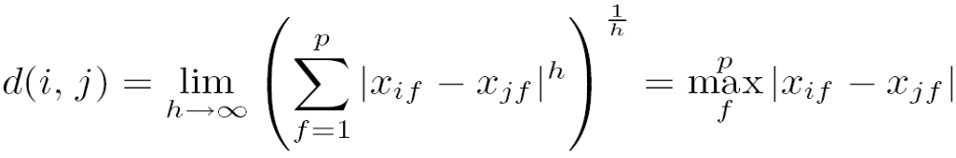
Special Cases of Minkowski Distance
h = 1: Manhattan (city block, L₁ norm) distance
  E.g., the Hamming distance: the number of bits that are different between two binary vectors
h = 2: (L₂ norm) Euclidean distance
h → ∞. “supremum” (L_{max} norm, L∞ norm) distance.
  This is the maximum difference between any component (attribute) of the vectors

Slide 22
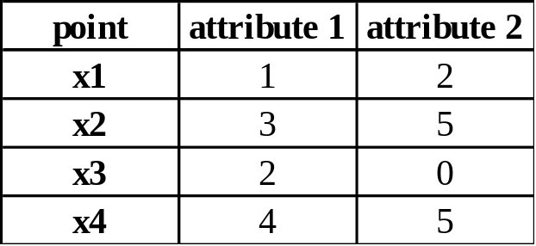
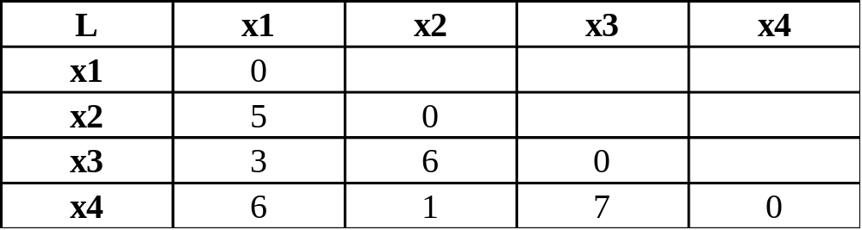
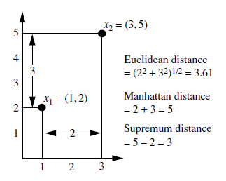
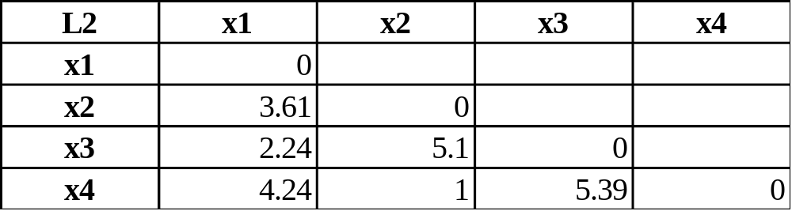
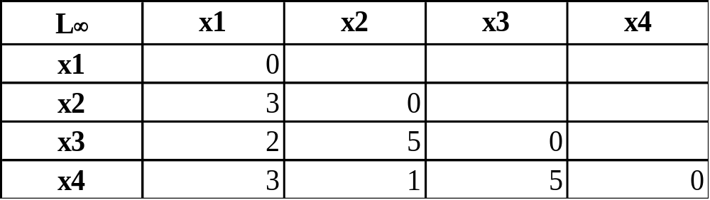
Example: Minkowski Distance
Dissimilarity Matrices
Manhattan (L₁)
Euclidean (L₂)
Supremum
Notes:
In the example above Manhatten distance = |3-1| + |5-2| = 2 + 3 = 5
Supremum distance = max(3,5) – max(1,2) = 5 – 2 = 3

Slide 23


Ordinal Variables
An ordinal variable can be discrete or continuous
Order is important, e.g., rank
Can be treated like interval-scaled
  replace x_{if} by their rank
  map the range of each variable onto [0, 1] by replacing i-th object in the f-th variable by
  compute the dissimilarity using methods for interval-scaled variables

Slide 24
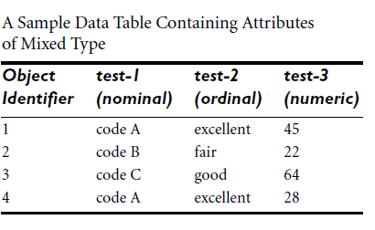
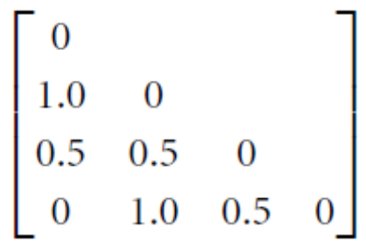
Ordinal Variables
There are three states for test-2: fair, good, and excellent, that is, M_{f} = 3.
For step 1, if we replace each value for test-2 by its rank, the four objects are assigned the ranks 3, 1, 2, and 3, respectively.
Step 2 normalizes the ranking by mapping rank 1 to 0.0, rank 2 to 0.5, and rank 3 to 1.0.
For step 3, we can use, say, the Euclidean distance equation, which results in the following dissimilarity matrix:

Slide 25
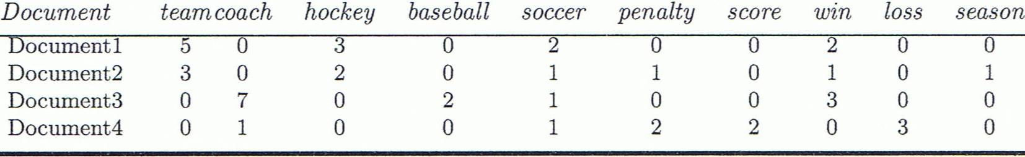
Cosine Similarity
A document can be represented by thousands of attributes, each recording the frequency of a particular word (such as keywords) or phrase in the document.
Other vector objects: gene features in micro-arrays, …
Applications: information retrieval, biologic taxonomy, gene feature mapping, ...
Cosine measure: If d₁ and d₂ are two vectors (e.g., term-frequency vectors), then
cos(d₁, d₂) = (d₁ • d₂) /||d₁|| ||d₂|| ,
  where • indicates vector dot product, ||d||: the length of vector d

Slide 26
Example: Cosine Similarity
cos(d₁, d₂) = (d₁ • d₂) /||d₁|| ||d₂|| ,
  where • indicates vector dot product, ||d|: the length of vector d
Ex: Find the similarity between documents 1 and 2.
  d₁ = (5, 0, 3, 0, 2, 0, 0, 2, 0, 0)
  d₂ = (3, 0, 2, 0, 1, 1, 0, 1, 0, 1)
  d₁•d₂ = 5*3+0*0+3*2+0*0+2*1+0*1+0*1+2*1+0*0+0*1 = 25
  ||d₁||= (5*5+0*0+3*3+0*0+2*2+0*0+0*0+2*2+0*0+0*0)^{0.5}=(42)^{0.5} = 6.481
  ||d₂||= (3*3+0*0+2*2+0*0+1*1+1*1+0*0+1*1+0*0+1*1)^{0.5}=(17)^{0.5} = 4.12
  cos(d₁, d₂ ) = 0.94

Slide 27
Chapter 2: Getting to Know Your Data
Data Objects and Attribute Types
Basic Statistical Descriptions of Data
Data Visualization
Measuring Data Similarity and Dissimilarity
Summary

Slide 28
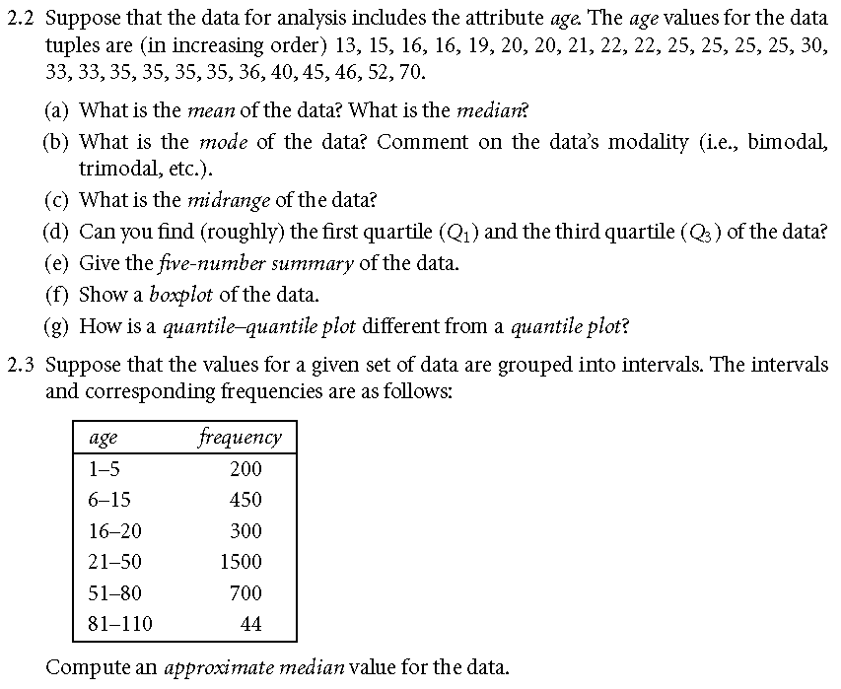

Slide 29
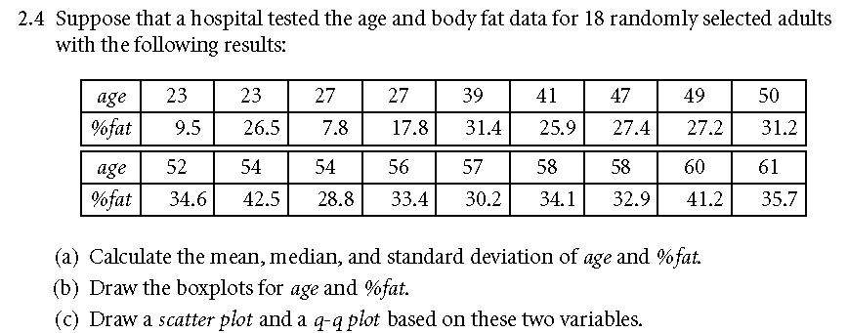
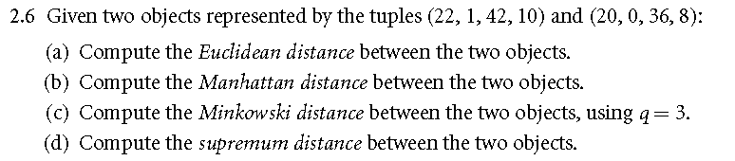

Slide 30
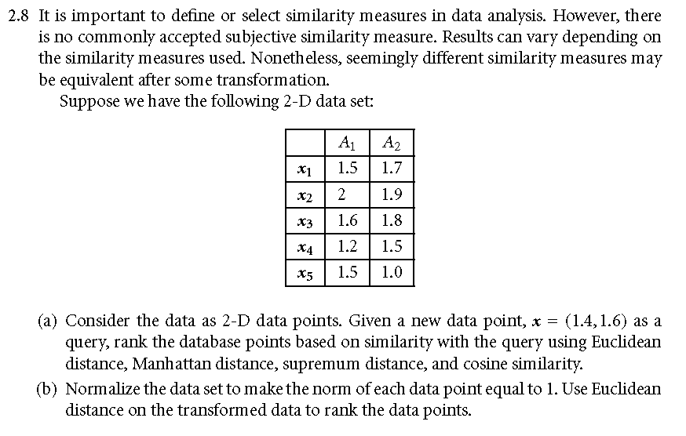

Slide 31
Summary
Data attribute types: nominal, binary, ordinal, interval-scaled, ratio-scaled
Many types of data sets, e.g., numerical, text, graph, Web, image.
Gain insight into the data by:
  Basic statistical data description: central tendency, dispersion, graphical displays
  Data visualization: map data onto graphical primitives
  Measure data similarity
Above steps are the beginning of data preprocessing.
Many methods have been developed but still an active area of research.

